Slide 1
Comprehensive Digital Marketing for Tech Mahindra

Slide 2

Presenting by
Team Lead
P. Manasa (SBAP0010422)
Team Members
S.Sireesha
S.Bhavani
S.Bhargavi
P.Supriya

Slide 3

TECH MAHINDRA
Tech Mahindra is an Indian multinational information technology services and consulting company. Part of the Mahindra Group, the company is headquartered in Pune and has its registered office in Mumbai. Tech Mahindra is a US$6.0 billion company with over 148,000 employees across 90 countries.

Slide 4

Brand study , Competitor’s Analysis and Buyer’s/Audience’s persona
Research of Brand Identity
Mission/Values : The mission is to build smart machines of the future. These smart machines include solving intelligence at its primal level and then applying that intelligence to products and IPs.
Their mission includes solving AI, and it’s an approach to a practical commercial model to be used for the company and industry at large.
USP : Tech Mahindra has a strong focus on digital transformation services, including cloud computing, artificial intelligence, internet of things (IoT), and block chain. They help businesses adapt to the digital age and leverage emerging technologies for growth.
Tech Mahindra is one of the world's first website to run on Dark Mode by default.
The company offers industry-specific solutions and services tailored to various sectors such as telecommunications, healthcare, manufacturing, financial services, and more. This specialization allows them to address the unique challenges of different industries effectively.

Slide 5
Analyzing of Brand messaging :
Tagline : CONNECTED WORLD. CONNECTED EXPERIENCES
Logo : The Tech Mahindra logo is a wordmark with two colors. The logo's word mark is a fully customized font and is completely unique to us. It has mild serifs that give it a structured, classic, sophisticated feel.
Innovation : Their Innovation aims to be inclusive of all their stakeholders and represents the common good of all sections. Their mission is to empower lives, embrace livelihoods, and enhance technologies.
Values : Inclusivity is a part of their overall agenda and inclusion through product, platform, and processes are constant. We call this ThinkNxT which is the core of their philosophy.
Digital Transformation: Given its focus on digital transformation services, Tech Mahindra's brand identity often emphasizes its role in helping businesses navigate the digital era and harness emerging technologies.

Slide 6
Smart Goals :
Tech Mahindra Launches 5G-Enabled Solution to Build Wireless and Secure ‘Factory of the Future’’.
Tech Mahindra and Keysight Collaborate to Accelerate Adoption of 5G Devices Globally.
Tech Strategy: Fully integrated Digital Marketing Technology (DMT) stack, with access to Unified Customer profile across all the touch-points to deliver Next Best Experience at scale and drive data-driven marketing automation.
Tech Mahindra has built pioneering systems, processes, and solutions, for enterprise clients across the globe. Sitting at the intersection of change, it’s time to deliver the future of industries. Introducing NXT.NOW™.
Tech Mahindra Achieves AWS Level 1 Managed Security Service Provider (MSSP) Competency Status covering all Six Cybersecurity Cloud domains.

Slide 7
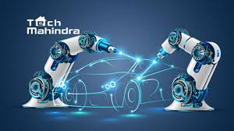
KPIs of Tech Mahindra:
Revenue Growth: Monitoring year-over-year growth in revenue to assess the company's financial health and expansion.
Client Satisfaction: Using customer surveys and feedback to gauge client satisfaction levels.
Quality Assurance Metrics: Monitoring the number of defects or issues in software projects to ensure quality.
Environmental and Social Responsibility: Tracking efforts related to sustainability and corporate social responsibility.
Project Delivery Time: Tracking the time it takes to complete projects within specified deadlines.

Slide 8
Competitors Analysis :
Competitors to Tech Mahindra are
Competitor 1 : Wipro
USP : Offers a comprehensive range of IT services, including consulting, application development, infrastructure services, and BPO. Strong focus on AI and automation.
Online Communication : Wipro has a presence on major social media platforms such as LinkedIn, Twitter, Facebook and Instagram. Wipro conducts webinars, virtual events, and online conferences to share insights, discuss industry trends, and showcase its solutions.
SWOT Analysis :
Strengths :Diverse Service Offerings: Wipro provides a wide range of IT services, including software development, consulting, business process outsourcing, digital transformation, and cloud services, making it adaptable to diverse client needs.
Weaknesses :Competitive Pressure: The IT services industry is highly competitive, and Wipro faces competition from other major players such as Tata Consultancy Services (TCS), Infosys, and global firms like IBM and Accenture.
Opportunities :Digital Transformation: The growing demand for digital transformation services presents significant opportunities for Wipro.
Threats : Data Security and Privacy Concerns: Data breaches and privacy issues could affect Wipro's reputation and lead to legal consequences.

Slide 9
Competitor 2 : Tata Consultancy Services
USP : TCS stands out for its scale, global reach, industry expertise, and commitment to research and sustainability. On the other hand, Tech Mahindra is known for its digital transformation focus, telecommunications expertise, innovation initiatives, and client-centric approach.
Online Communication :TCS maintains an official website (www.tcs.com) where they provide information about their services, solutions, and corporate information.
TCS may offer live chat and online support options for client inquiries and technical assistance.
SWOT Analysis :
Strengths : Strong Brand Reputation: TCS is well-regarded in the IT industry, known for its quality services and a history of successful client partnerships.
Weaknesses : Over-Reliance on Specific Sectors: TCS may face over-reliance on specific industries, such as financial services for TCS, making them vulnerable to industry-specific economic downturns.
Opportunities : Emerging Technologies: TCS can capitalize on emerging technologies like IoT, 5G, AI, and automation to improve its service offerings and efficiency.
Threats : Data Security and Privacy Concerns: Data breaches and privacy issues could affect the reputation of TCS and lead to legal consequences.

Slide 10
Competitor 3 : Infosys
USP : It has a strong global presence and provides a wide range of services including software development, system integration, consulting, and outsourcing.
Online Communication :some potential distinctive online communication practices used by Infosys are Infosys Knowledge Institute, Infytv, Infychat, Investor Relations Portal
SWOT Analysis :
Strengths : Strong Brand Reputation: Infosys is well-regarded in the IT industry and is known for its quality services, a history of successful client partnerships, and a commitment to innovation.
Weaknesses :Over-Reliance on North America: A significant portion of Infosys's revenue comes from North America, making it vulnerable to economic downturns or changes in regulations in that region.
Opportunities : Blockchain and IoT: Infosys can capitalize on the growth of blockchain technology and the Internet of Things (IoT) in various industries.
Strategic Partnerships: Collaborating with technology companies, startups, and academic institutions can lead to innovative solutions and access to new markets.
Threats : Regulatory Changes: Changes in data protection and immigration regulations can impact Infosys's operations and workforce.

Slide 11
Buyer’s /Audience Persona :
Tech Mahindra, as a global IT services and consulting company, serves a diverse range of clients across various industries.
Tech Mahindra’s target audience considering demographics, psychographics, behaviors, and interests are
Large Enterprises: Tech Mahindra serves Fortune 500 companies and other large organizations across various sectors, including telecommunications, healthcare, finance, retail, manufacturing, energy, and government agencies and these companies are main target audience for Tech Mahindra.
Clients who located globally, with a significant presence in North America, Europe, Asia, and other regions are target audience of Tech Mahindra on considering Demographic
The companies which Interested in network optimization and innovation to deliver the best customer experience.
One who Focused on 5G technology, IoT, and digital transformation to stay competitive.
One who Emphasizes patient care, EHR, and data security in Health care systems
One who is being ready to Rapid technology adoption and innovation in the telecommunications sector and Emphasizing customer experience and network reliability.
Who Invests heavily in research and technology evaluation and Seeks long-term partnerships with technology service providers.
Global Retail corporations which Interested in e-commerce, supply chain, and customer experience and Seeks cost-effective solutions to enhance profitability.

Slide 12
SEO and KEYWORD RESEARCH
SEO Audit :
Website Traffic :In September techmahindra.com received 1.7M visits with the average session duration 07:36. Compared to August traffic to techmahindra.com has increased by 30.2%.
Back link Analysis : In September the number of back links to techmahindra.com has dropped by -7.8% and equals 198.7K. The amount of referring domains has increased by 1.8% and equals 9.4K.
Mobile Friendly : techmahindra.com is Mobile Friendly
Duplicates : There is no duplicates for techmahindra.com
No Malware found in the website
0 pages were blocked by robots.txt
No pages have content with Low word count
No pages without headers are detected
Found 5 page Redirects

Slide 13
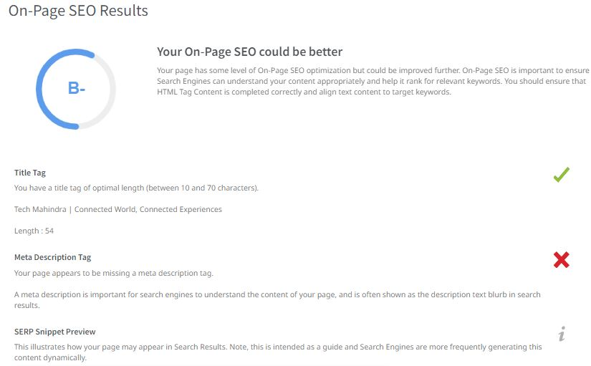

Slide 14
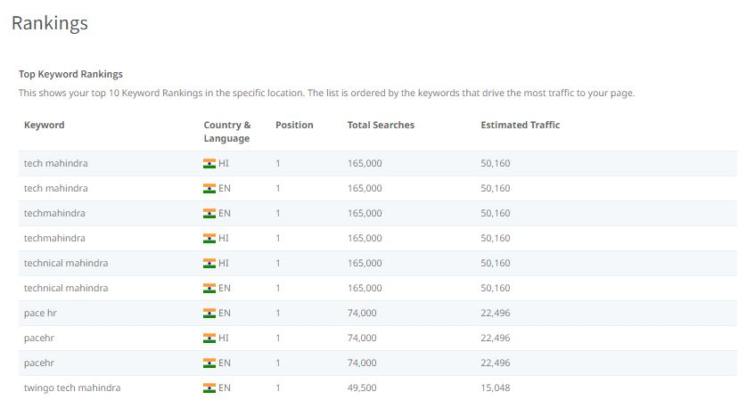

Slide 15
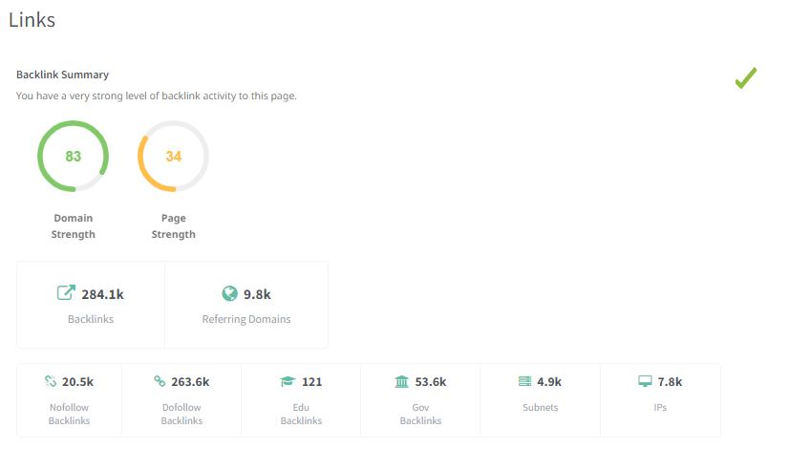

Slide 16
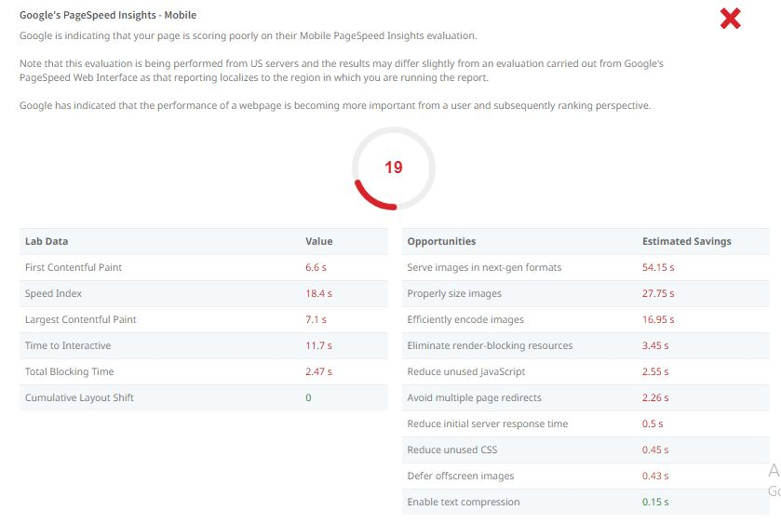

Slide 17
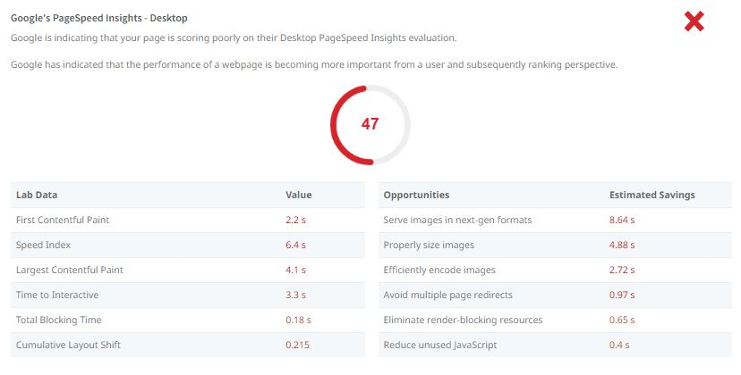

Slide 18

Keyword Research
Keyword Research Objectives
Brainstrom of seed Keywords
Identifying High value Service Keywords
Discovering Industry Specific Keywords
Long tail Keyword Research
Branded Keywords
Competitor Keyword Analysis

Slide 19
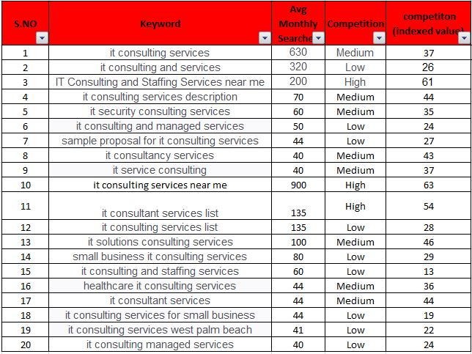

Slide 20
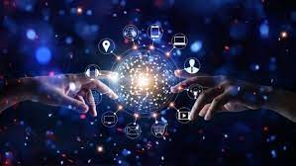
Seed Keywords for Tech Mahindra
Tech Mahindra
IT Services
Technology Consulting
Digital Transformation
Information Technology
Software Solutions
Business Process Outsourcing
Cybersecurity Services
Cloud Computing
Telecommunications Solutions
Artificial Intelligence (AI)
Internet of Things (IoT)
Blockchain Technology
Data Analytics
Big Data Solutions
Mobile App Development
Managed IT Services
Network Optimization
Healthcare IT Solutions
Financial Technology (FinTech)

Slide 21
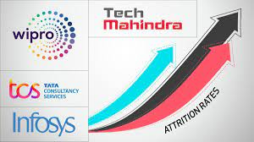
Competitor Keywords for Tech Mahindra
"Tata Consultancy Services (TCS)"
"Wipro"
"HCL Technologies"
"Cognizant"
"Accenture"
"IBM Global Services"
"Capgemini"
"DXC Technology"
"Tech Mahindra competitors"
"IT services companies"
"Software outsourcing companies"
"Telecommunications services providers"
"Digital transformation services"
"Cybersecurity solutions"
"Cloud computing services"
"AI and machine learning services"
"Enterprise software development"
"Business process outsourcing (BPO)"
"Consulting and technology solutions“.

Slide 22
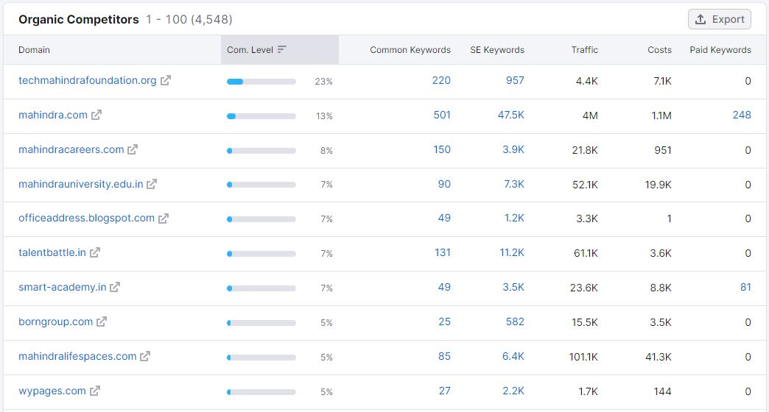

Slide 23
Long tail Keyword Exploration
"Tech Mahindra IT consulting services"
"Tech Mahindra digital transformation solutions"
"Tech Mahindra telecommunications technology expertise"
"Tech Mahindra software development and integration"
"Tech Mahindra AI and machine learning solutions"
"Tech Mahindra cyber security services for businesses"
"Tech Mahindra cloud computing solutions"
"Tech Mahindra IoT implementation in industries"
"Tech Mahindra 5G technology consulting"
"Tech Mahindra data analytics and BI solutions"
"Tech Mahindra robotic process automation (RPA)"
"Tech Mahindra industry-specific technology solutions"
"Tech Mahindra financial services technology"
"Tech Mahindra automotive industry tech solutions"
"Tech Mahindra customer experience optimization"
"Tech Mahindra sustainability and green technology"
These long-tail keywords can help Tech Mahindra target specific niches and showcase their expertise in various technology-related domains, making their content more relevant to potential clients and improving their online visibility.

Slide 24
On page Optimization
Meta Description Tag
Techmahindra.com page appears to be missing a meta description tag. A meta description is important for search engines to understand the content of page, and is often shown as the description text blurb in search results.
XML Sitemaps
Have not detected or been able to retrieve a XML sitemaps file successfully. Sitemaps are recommended to ensure that search engines can intelligently crawl all of pages.
Image Alt Attributes
You have images on your page that are missing Alt attributes.
Found 148 images on the page and 144 of them are missing the attribute. Alt attributes are an often overlooked and simple way to signal to Search Engines what an image is about, and help it rank in image search results.

Slide 25
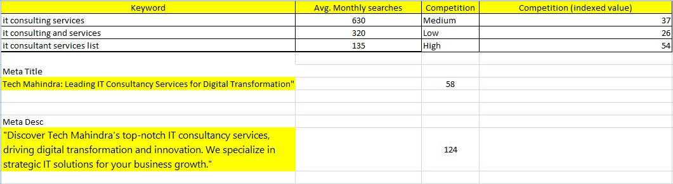

Slide 26
Content Ideas and Marketing Strategies
Date | Content Type | Topic | Target Audience | Key Message | Platform | Notes
11/01/23 | Blog Post | “The future of 5G” | Tech Enthusiasts | Exploring 5G’s impact on industries | Website LinkedIn | Incorporate Relevant statistics
11/05/23 | Social media post | “Tech Mahindra Innovations” | Industry Professionals | Highlight recent tech solutions | Twitter,LinkedIn | Include eye-catching visuals
11/10/23 | Email Newsletter | ‘Digital Transformation Insights” | Subscribers | Share success stories and case studies | Email | Segment for different industry sectors
11/15/23 | Webinar | “AI in Health care” | Healthcare Professionals | Expert panel Discussion | Webinar Platform | Promote registration and speakers
11/20/23 | Infographic | ‘Cyber security Trends” | IT Managers | Visual representation of Key trends | Social Media Website | Keep it concise and informative
11/25/23 | Video | “Tech Mahindra CSR Initiatives” | General Public | Showcase corporate social responsibility | Youtube, Website | Feature employees and community impact

Slide 27
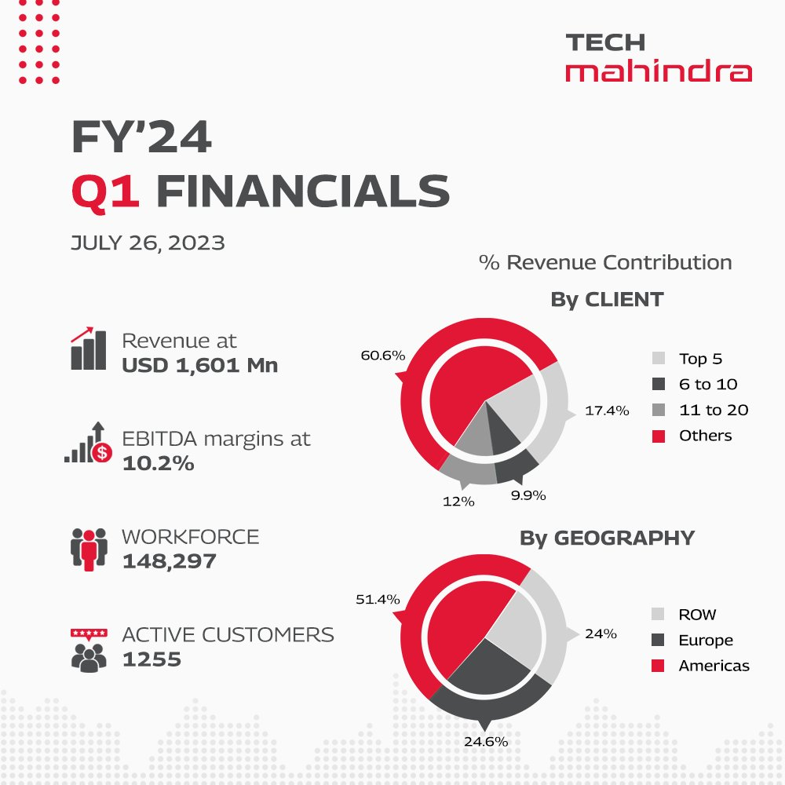
Content creation
Explore the Future of Tech! Our latest info graphic breaks down the top IT trends in 2023.
View Infographic

Slide 28

Get ready to navigate Private 5G successfully with Tech Mahindra and Red Hat. Explore how enterprises can embark on a multi-step journey to build meaningful use cases leveraging end-to-end private 5G solutions. Save the date and register now: https://lnkd.in/duPP8nJN 23rd October 2023 | 09:00 a.m. EDT / 02:00 p.m.

Slide 29

Tech Mahindra Inaugurates Innovation Centre in Espoo, Finland to Drive Digitization with Customers
To Know more click here
Tech Mahindra

Slide 30
Instagram Story
Instagram Story Link https://instagram.com/stories/tech.mahindra1/3212478601899197356?utm_source=ig_story_item_share&igshid=YTUzYTFiZDMwYg==
Highlight Link :
https://www.instagram.com/s/aGlnaGxpZ2h0OjE3OTUzMDc4MTYzNTY4MDAw?igshid=MmU2YjMzNjRlOQ==
Instagram Account Link :
https://instagram.com/tech.mahindra1?igshid=NGVhN2U2NjQ0Yg==

Slide 31
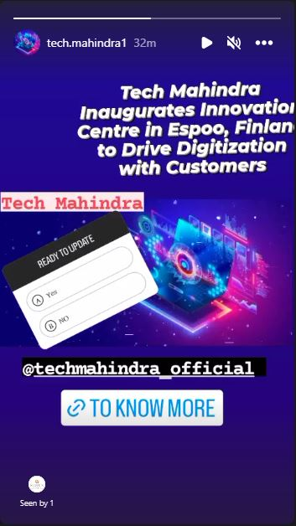
Instagram Story

Slide 32
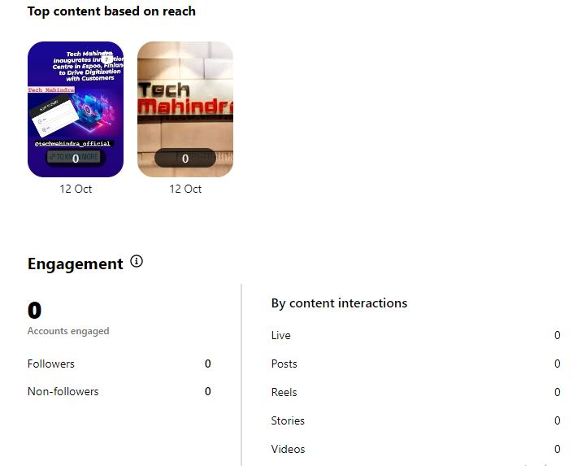
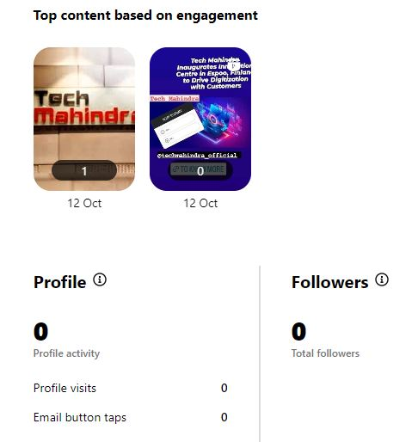
Insights
Strategies have to follow in order to increase the post engagement are
Post High–Quality Content, Engage with Your Audience
Use Hash tags Strategically Run Contests and Giveaways
Collaborate and Tag Others Use Instagram Ads

Slide 33
Thank you

